Slide 1
Flu Shot Learning Predict H1N1 and Seasonal Flu Vaccine
Name : Faiza A.Qadir

Slide 2
Introduction
The H1N1 Flu, which emerged in the USA in 2009 and spread to the rest of the world, has had a huge impact on the lives of people around the world
Vaccination was the first and most important step to be taken, as it is seasonally circulating around the world
This is why a vaccination campaign was organized by the United States government and monitored by the National 2009 H1N1 Flu Survey (NHFS)
In this analysis, we use the data from the survey to predicts how likely people age-wise, racisms-wise, education-wise got H1N1 flu vaccine.
Also find the seasonal and H1N1 flu vaccine Mean and Median

Slide 3
Dataset Used
The data set used is from the National 2009 H1N1 Flu Survey (NHFS)
The survey has been carried out by the Centers for Disease Control and Prevention (CDC) since the 2010-11 influenza season
Its main purpose was to monitor and evaluate H1N1 flu vaccine efforts among adults and children
It provides us with details such as the H1N1 and seasonal influenza vaccination status of adults and children, as well as influenza vaccination status, views on the safety and efficacy of influenza vaccine, recent respiratory illnesses and pneumococcal vaccination status

Slide 4
Data Preparation
We have received multiple sources of data which contain null values and missing values
This data need to be prepared for analysis by elimination all the garbage from provided data
Also data need to be categorized
After performing all the basic cleaning of data, we will merge the data to get a train_test_data

Slide 5
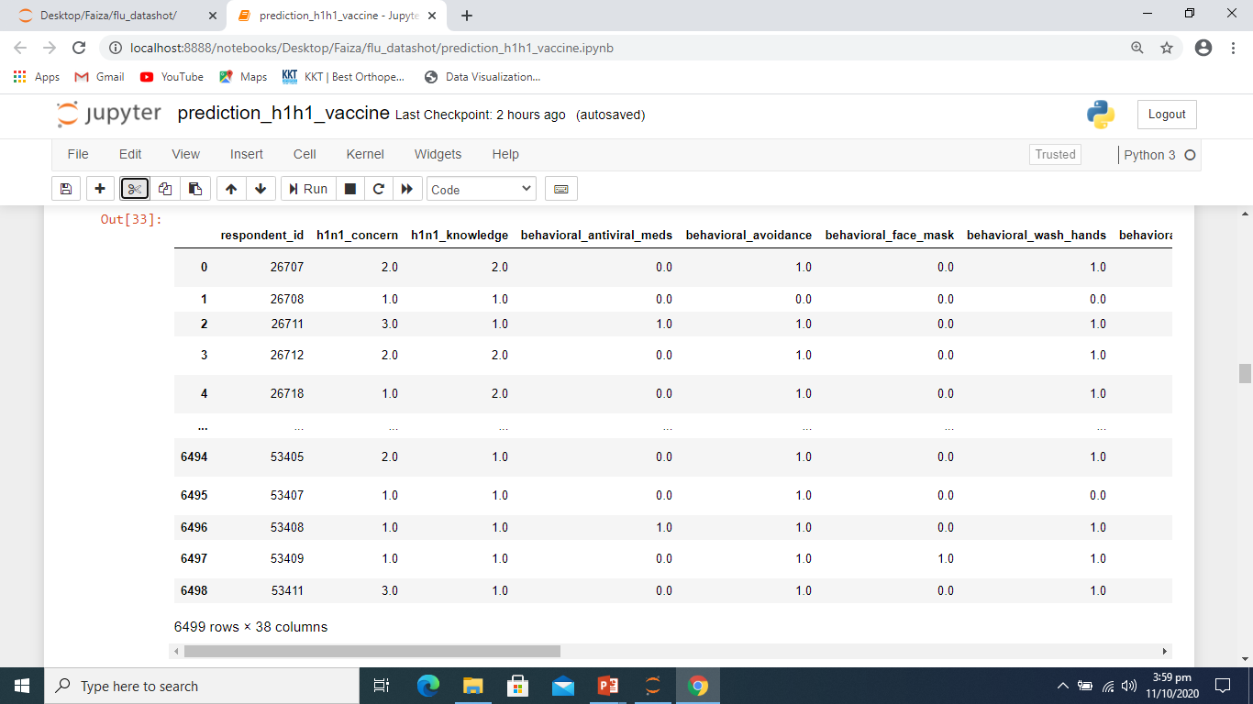
Train_Test_Data Sample

Slide 6
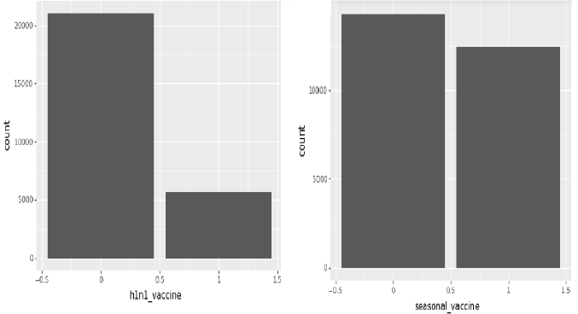
Create Graphs
With the help of graphs, we will differentiate between H1N1 and Seasonal Vaccine
How many people got the seasonal vaccine and how many people got the H1N1 vaccine
Only about 20% of people have received the H1N1 flu vaccine.

Slide 7
Comparison with different Parameters
It turned out that H1N1 flu has an interesting relationship with different parameters: While we know something about causality from this analysis, risk factors appear to be reflected in vaccination rates
Following parameters are used in analysis to compare the vaccine
By age
By Racisim
By Education
By Income

Slide 8
Mean and Median of Seasonal and H1N1 Vaccine
Probability has a stronger association with seasonal vaccine, but h1n1_vaccine is much less so so far. We see a particularly strong correlation with age_group with seasonal vaccine, but not with h1n1_vaccine
With seasonal flu, it seems, people are acting appropriately by the fact that people are more affected and
The risk of flu-related complications is higher with age, impoverty, racisim
It turned out that H1N1 flu has an interesting relationship with age: Even if older people had a higher risk of complications, they were less likely to become infected! While we know something about causality from this analysis, risk factors appear to be reflected in vaccination rates

Slide 9
Future Research Scope and Conclusion
In the future, with advances in technology, the quality and quantity of data may increase, resulting in better performance and analysis of the problem. More information about the seasons, especially the non-epidemic seasons, can be of great help in analyzing this project.
It has been observed that hyperparameter tuning yielded better results for H1N1 flu vaccination prediction.
For Seasonal flu vaccination prediction hyperparameter tuning didn’t obtain expected accuracy.

Slide 10
Thank You

